Slide 1
Index Announcement Effect
By Matt Silva

Slide 2
Table of Contents
Summary of Problem
Data
Data Comparison
T-Test Results
Moving Forward
What I learned
Questions?

Slide 3
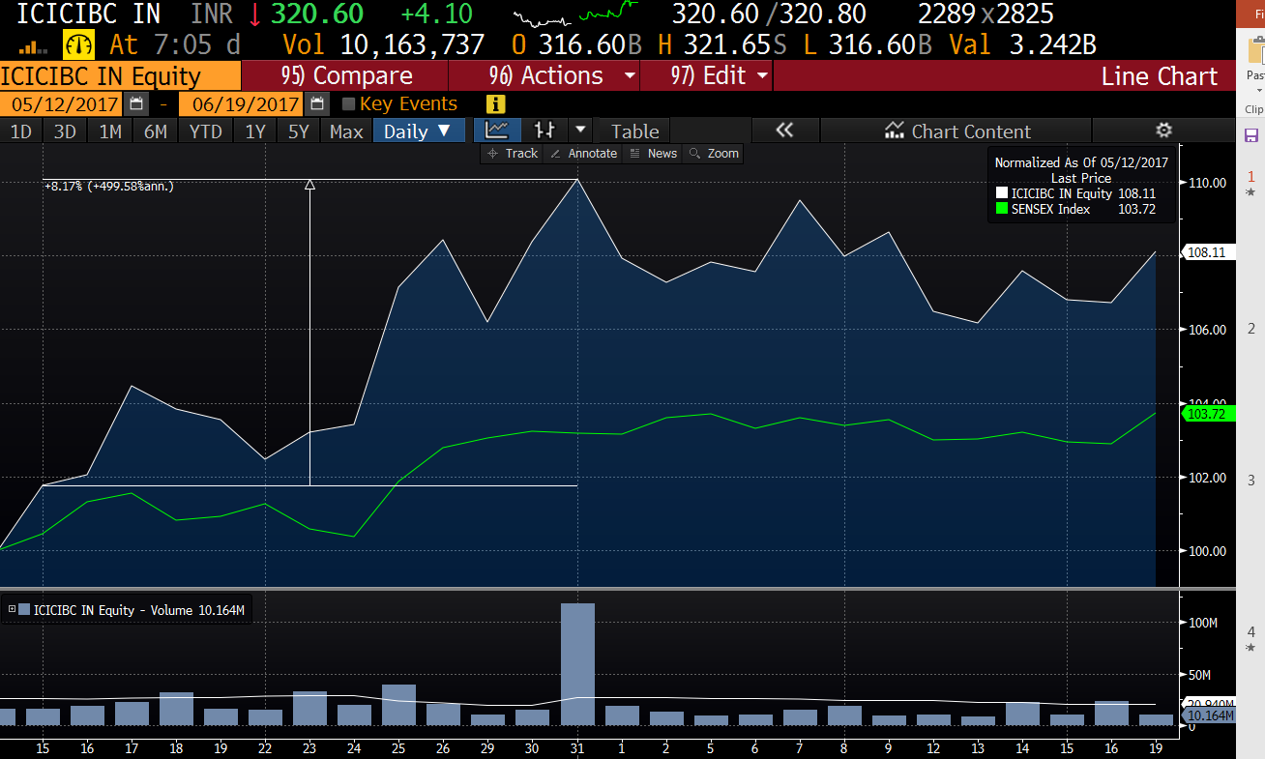
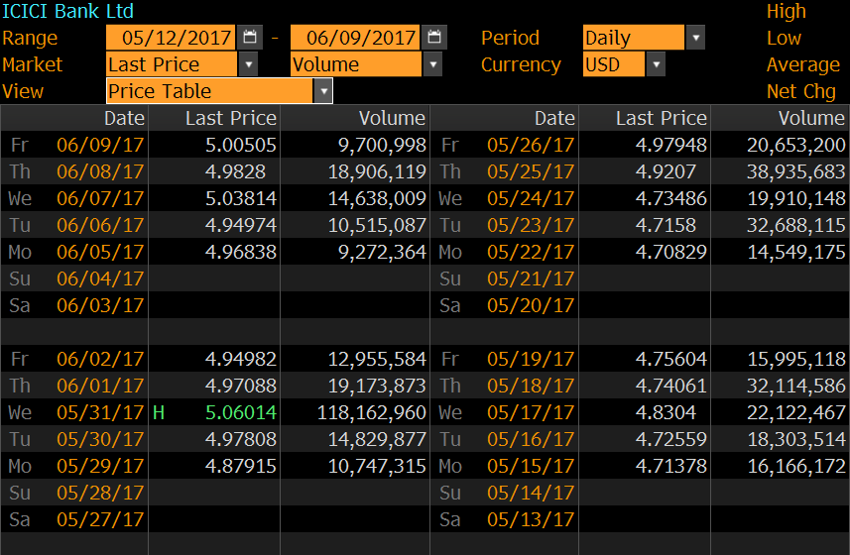
Summary of Problem
Hypothesis: Index announcements create structural market changes to securities until the close of effective date. Using volume data I can predict the how the security will trade on effective date.

Slide 4
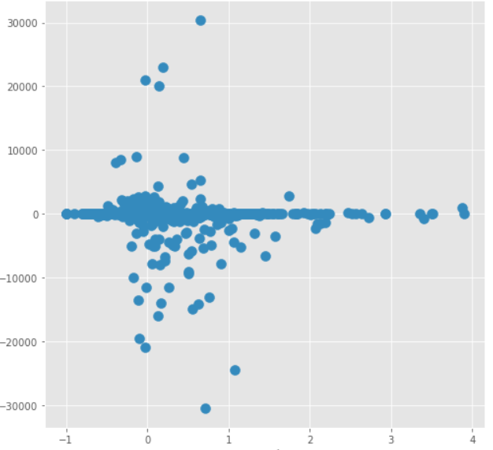
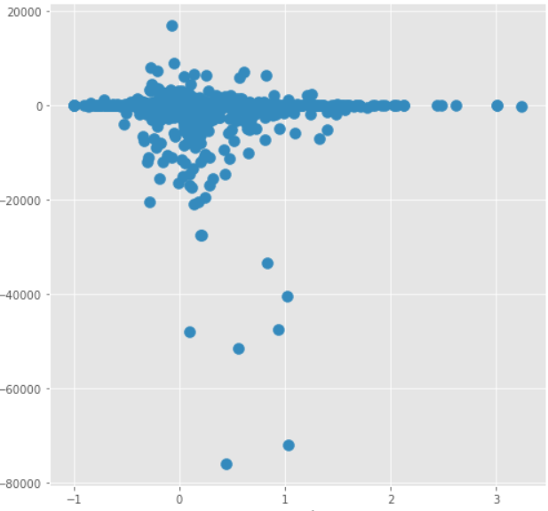
Data Comparison
Index Change
No Index Change
Price Change on Effective Date %
Price Change on Effective Date %
Excess Volume (%)
Excess Volume (%)

Slide 5
T-Test Results
 | T-Statistic | P-Value
Excess Volume | 6.52069E-05 | 0.409
Price Change Effective Date | 0.002678343 | 0.474
With small T values and large P values it is clear that there is not a statistical difference between the behavior of securities affected by an index announcement and securities that were not affected by the index announcement.

Slide 6
Moving Forward
Get better data for August Rebalance
Refine scope of study to include only securities with over a certain percentage change in weight to the index
Use a metric to eliminate securities where the index change is smaller than 1 days volume
Collect more data and different types of data. (price changes, post trade prices and volume, pre announcement positioning, and analyst sentiment)

Slide 7
What I Learned
Have a clear plan from the start before collecting information.
Data collection is paramount. I received bad data from our data integrity group when I went back to request more information.
Indexing is still a small part of the market. Despite not getting significant results this quarter, as assets move in ETF’s and Index funds maybe my theory will eventually be significant

Slide 8
Question?
Matt.Silva@blackrock.com

